Slide 1
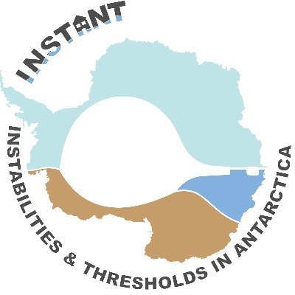
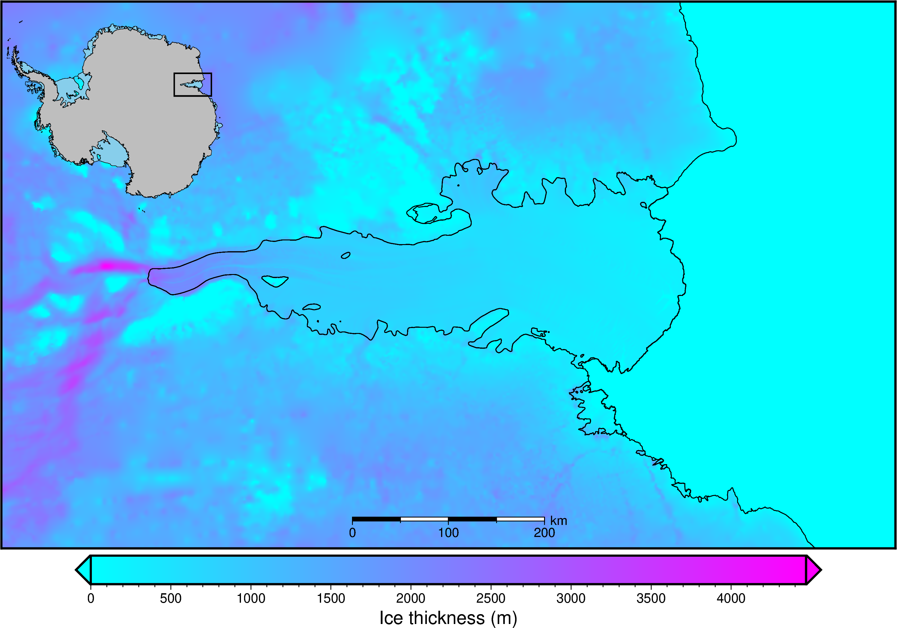
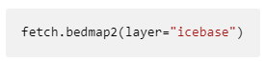
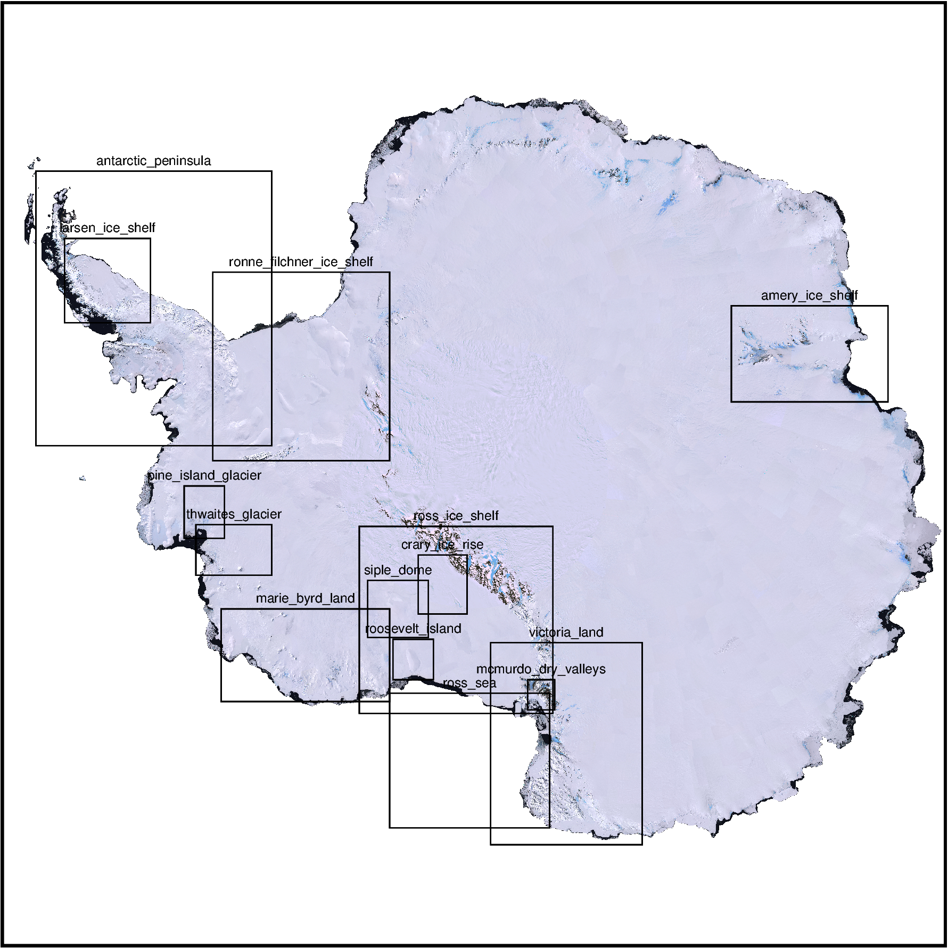
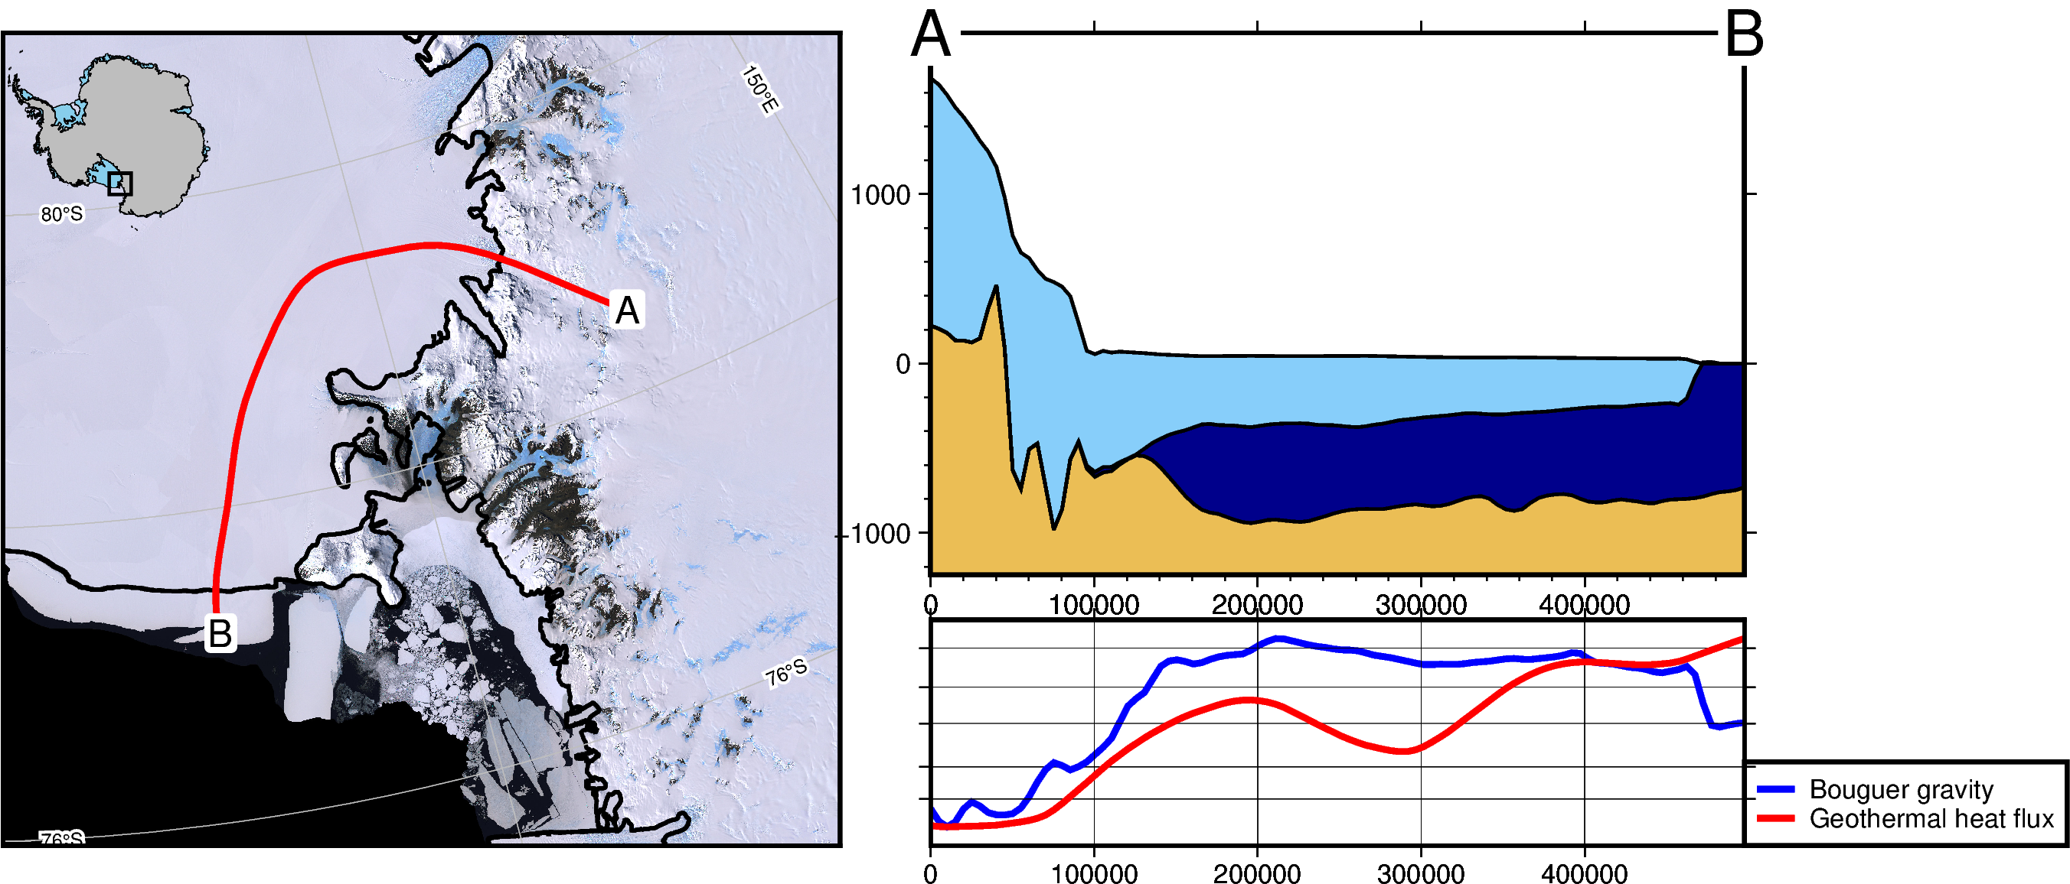
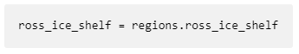



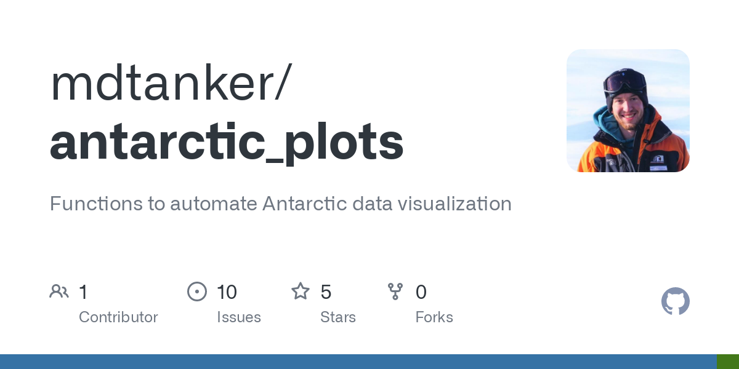
Antarctic-Plots:
A Python package to help download, visualize, and present Antarctic datasets
Matthew Tankersley^{1,2 1}Antarctic Research Centre, Victoria University of Wellington, NZ ²GNS Science,
Introduction
Antarctic-Plots is a new Python package developed to help with conducting Antarctic science. The 5 modules listed below all provide useful functions for a variety of use cases.
from antarctic_plots import fetch
The fetch module provides an organized and convenient method of downloading and datasets. It uses the package Pooch to download data, or if the data’s already download, just retrieves the file for you. Below are some of the datasets including in fetch. More to be added in time!
from antarctic_plots import regions
The regions module helps with defining geographic regions for plotting or extracting portions of data. There are several pre-defined regions (some shown below) for commonly plotted areas, or you can use an interactive map to define a custom region.
# download
ice_thickness = fetch.bedmachine(
layer = "thickness",
region = regions.amery_ice_shelf,
spacing = 1000)
# plot
fig = maps.plot_grd(
grid = ice_thickness,
cmap = "cool",
coast = True,
cbar_label = "Ice thickness (m)",
inset = True,
scalebar = True)
# show
fig.show()
from antarctic_plots import maps
The maps module gives tools for easily create high-quality maps using the package PyGMT. Either use maps entirely on its own or use it as an extension to simplify PyGMT. Below are some of the functions:
from antarctic_plots import profile
The profile module allows easy sampling of datasets along lines and plotting the results as cross sections and data profiles. It uses various packages, such as PyGMT and Verde for sampling and plotting. The main function is plot_profile() which allows 3 methods of defining a profile line:
1) a straight line between 2 points
2) the path of a shapefile
3) interactively drawing a line on a map.
from antarctic_plots import utils
The utils module provide several useful functions for general geoscience applications. allows easy sampling of datasets along lines and plotting the results as cross sections
plot_grd() helps easily create PyGMT maps, individually or as subplots.
add_coast() add coastline and groundingline to figure.
add_inset() add an inset map showing the figure region relative to the Antarctic continent.
add_gridlines() add lat lon grid lines and annotations to a figure.
add_scalebar() add lat lon grid lines and annotations to a figure.
Bedmachine
Bedmap2
DeepBedMap
Geothermal heat flux
Gravity
Magnetics
Grounding line
Coastline
Satellite imagery
Ice velocity
# download
gravity = fetch.gravity(type='BA')
GHF = fetch.geothermal(version='losing-ebbing-2021')
# set properties
data = profile.make_data_dict(
["Bouguer gravity", "Geothermal heat flux"],
[gravity, GHF],
["blue", "red"])
# draw profile location
lines = maps.draw_lines()
line = utils.shapes_to_df(lines)
# plot
profile.plot_profile(
method = "polyline",
polyline = line,
num = 100,
data_dict = data,
add_map = True)
Grid Operations:
grd_compare() Find the difference between 2 grids and plot the results.
grd_trend() Fit an arbitrary order trend to a grid and use it to detrend.
mask_from_shp() Create a mask or a masked grid from area inside or outside of a closed shapefile.
Coordinates and Projections:
set_proj() Create an EPSG:3031 projection to use in PyGMT based off an input region.
alter_region() Zoom in, out, or shift a region in any direction.
latlon_to_epsg3031() Convert coordinates from WGS84 (lat/long) into EPSG:3031, Antarctic Polar Stereographic.
Run the code online:
Open a Binder environment
Download the poster:
doi:
References
1. Cochran et al. 2014, DOI: 10.5067/OY7C2Y61YSYW
2. Brancolini et al. 1995, DOI: 10.1002/9781118669013
3. Tinto et al. 2019, DOI: 10.1038/s41561-019-0370-2
4. Lindeque et al. 2016, DOI: 10.1002/2016GC006401
5. Morlighem et al. 2020, DOI: 10.1038/s41561-019-0510-8
6. Shen et al. 2018, DOI: 10.1029/2017JB015346
7. Mouginot et al. 2019, DOI: 10.1029/2019GL083826
8. Burton-Johnson et al. 2020, DOI: 10.5194/tc-2020-59
Notes:
1 min intro:
30 sec run through:

